Slide 1
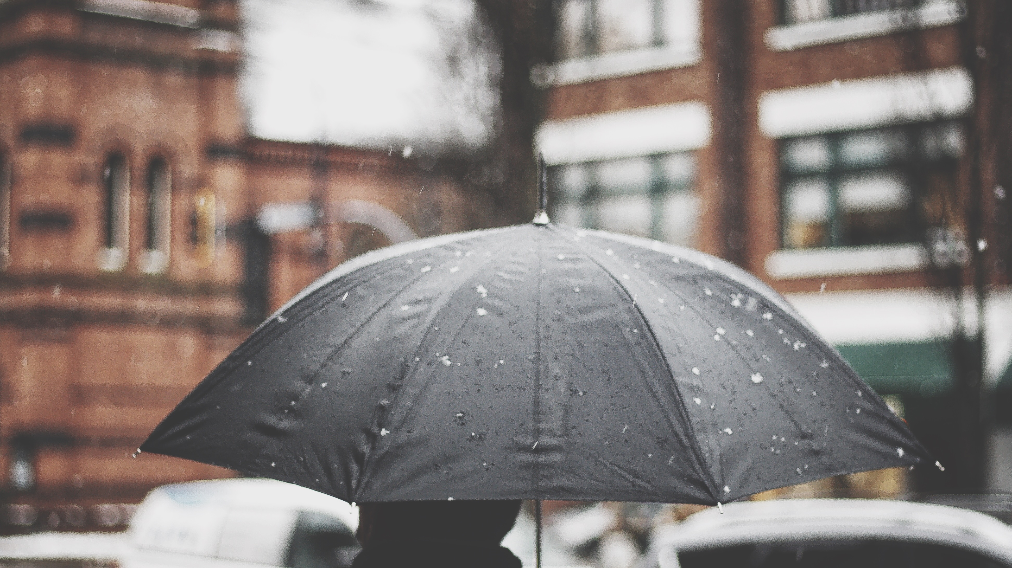
Crime Rate in relation to Weather in Atlanta
Can weather patterns be used to predict crime?

Slide 2

Presented by: The Crime Ninjas
Gary Groscost
Prudhvi Krishna Sannapareddy
Pradip Raodeo
Steven Rufus
Emmanuel Yoacel Okecha
Hwa Hara
James Dellinger
Kafayat Lawal
Megan Harper
Michael Damas

Slide 3
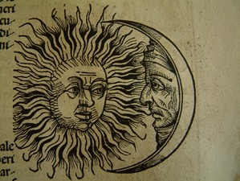
Background Information
Heat Hypothesis:
“The heat hypothesis states that hot temperatures can increase aggressive motives and behaviors”
Craig A Anderson – Dept. of Psychology, Iowa State University, Ames, Iowa
“Violent crime rates rose, on average, 5.7% on days when the temperature was above 85 degrees.”
Kilian Heilmann & Matthew E. Kahn – Dept. of Economics, University of Southern California, Los Angeles, California
Moon Phases and Behavior
” But now, my lord. It is the very error of the moon; She comes more nearer earth than she was wont, And makes men mad.”
Othello – William Shakespeare
81% of mental health workers claim a relationship between human illness and a full moon
Francis OJ, Kopke BJ, Affatato AJ, Jarski RW. Psychiatric Presentations During All 4 Phases of the Lunar Cycle.

Slide 4
Background Info Cont.
Part 1 Offenses
Serious crimes that occur on a regular basis and are likely to be reported to law enforcement
Standardized under the FBI Uniform Crime Reporting guidelines
Part 1 offenses used in our dataset and analysis taken from APD reporting
Aggravated Assault
Auto Theft
Nonresidential Burglary
Residential Burglary
Homicide
Vehicle Larceny
Non-Vehicle Larceny
Rape
Residential Robbery
Pedestrian Robbery
Commercial Robbery

Slide 5

Research Questions
Do certain weather conditions influence the volume of part 1 offenses in Atlanta, GA?
Do certain weather conditions influence the type of part 1 offenses committed in Atlanta, GA?
Does the Moon phase influence the volume or type of part 1 offenses in Atlanta, GA? Specifically the Full moon.
Can we predict the rate of part 1 offenses committed in Atlanta, GA using a linear regression model?

Slide 6
Data Visualization

Slide 7
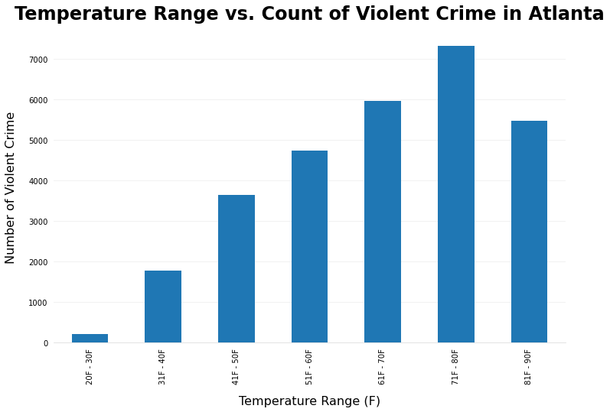
Temperature in relation to crime
Highest crime count occurs between 71-80 degree weather
Crime “sweet spot”
Crime is at its lowest in below freezing temperatures
No one really wants to commit crimes when it is freezing cold!

Slide 8
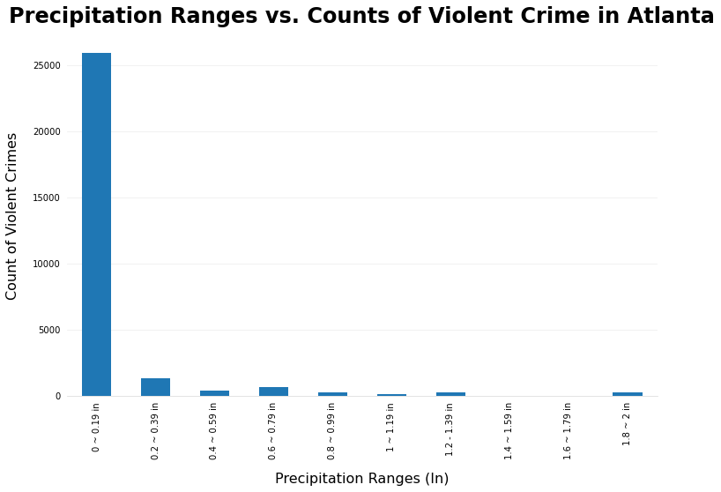
Precipitation in relation to crime
Highest crime counts occur in the smallest rain range 0-.19 inches.
This is contrary to pop culture depictions of crimes occurring during rainy/stormy weather
We can conclude that the “nicer” the weather, the more crimes occur.

Slide 9
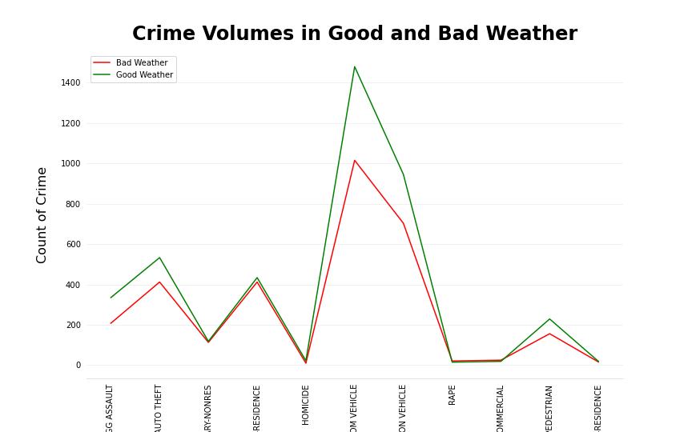
Good weather vs Bad weather
Bad Weather
Less than 50 more than 80 degrees
Precipitation greater than zero
Good Weather
More than 65 less than 75
Precipitation equals 0 inches
Homicides up by ~120%
10 Homicides bad weather vs 22 on good weather

Slide 10
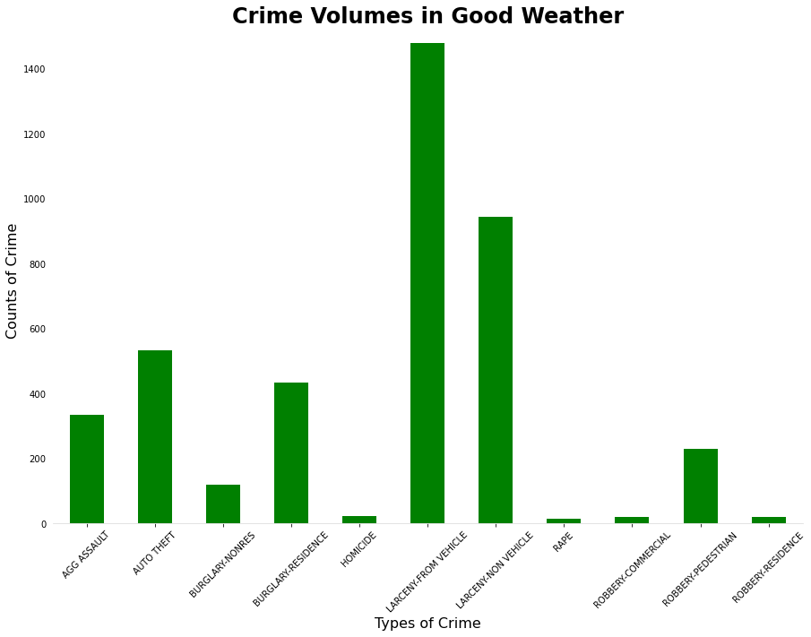
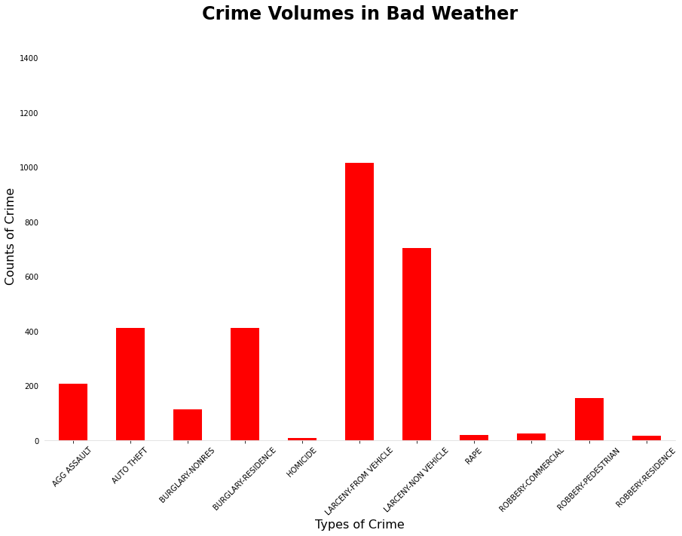
Good Weather VS Bad Weather

Slide 11
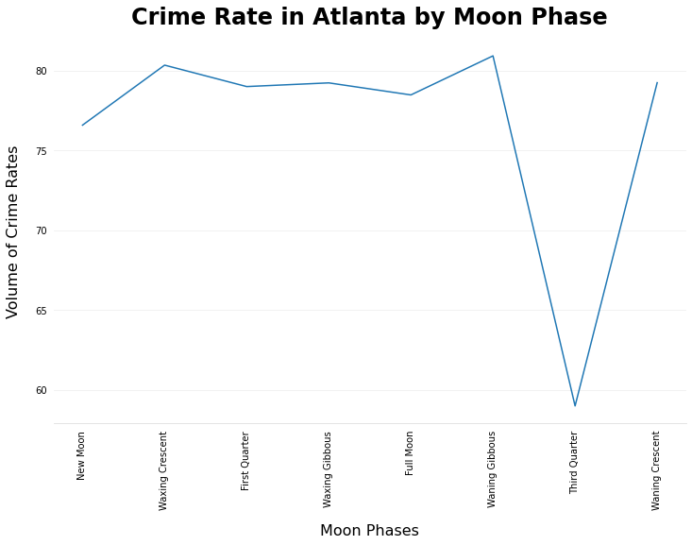
Moon phases in relation to crime
During third quarter moon, dip in crime
All other moon phases show similar crime rates.
We can conclude that less crime occur during the third quarter but no increase in crimes during full moon
Correlation does not equal causation!
Only two 2 days in the whole year!

Slide 12
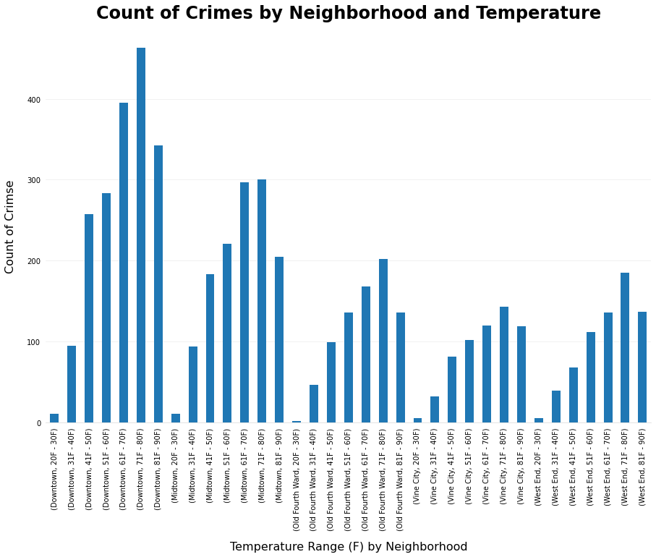
Crime data broken down by neighborhood
Top 5 neighborhoods with highest crime volume
Downtown
Midtown
Old Fourth Ward
Vine City
West end
Similar to earlier overall temperature graph with each neighborhood having a “sweet spot”

Slide 13
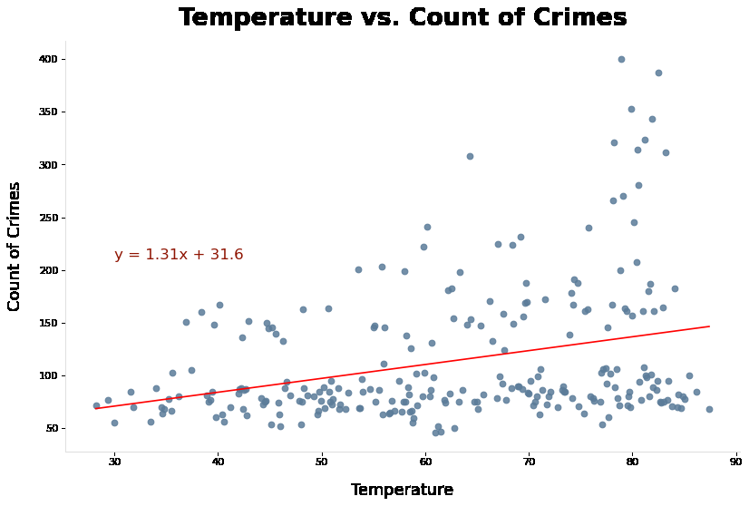
Prediction model based on Weather
Using a regression model we can predict
The higher the temperature, the higher the likeliness of crimes occurring within the Atlanta area.
R value= .097

Slide 14
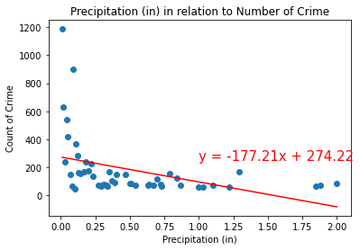
Prediction model based on Precipitation
Using a regression model based on precipitation we can predict:
The less precipitation, the higher the occurrence of crime and vice versa.
R value = .160
Zero values were removed.

Slide 15

Final Conclusions
Hotter weather does lead to higher crime rates, but there is a “sweet spot” of about 71-81 degrees Fahrenheit
Any higher and crime tends to dip down
All types of crime tend to increase in “Good” weather.
Vehicle larceny has the highest increase and highest count in both cases
The Full moon does not have marked difference in crime as previously posed in our research question
Using our regression models, we can predict crime rate and volume based on temperature and on precipitation
This Photo by Unknown Author is licensed under CC BY-SA

Slide 16

Limitations
Atlanta Weather is not broken down by neighborhood while crime type is broken down by neighborhood in our datasets
Our data does not really account for change in demographics
For example Old fourth ward and the gentrification that has occurred there
Weather and crime is not broken down by time of day.
Weather can change on an hour to hour basis but our datasets only show overall weather for the whole day
Specific weather data was limited to the year of 2016 as was our crime datasets from APD
This Photo by Unknown Author is licensed under CC BY

Slide 17
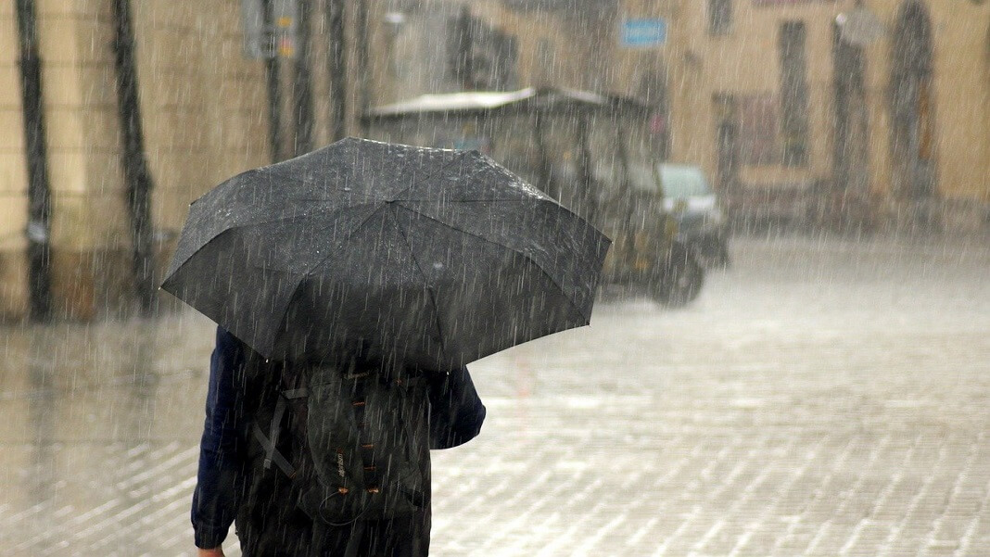
Thank you!
This Photo by Unknown Author is licensed under CC BY-ND

